Slide 1
Javascript

Slide 2
Definition - What does Scripting Language mean?
A scripting language is a programming language designed for integrating and communicating with other programming languages. Some of the most widely used scripting languages are JavaScript, VBScript, PHP, Perl, Python, Ruby, ASP and Tcl. Since a scripting language is normally used in conjunction with another programming language, they are often found alongside HTML, Java or C++.

Slide 3
difference
One common distinction between a scripting language and a language used for writing entire applications is that, while a programming language is typically compiled first before being allowed to run, scripting languages are interpreted from source code or bytecode one command at a time.
Although scripts are widely employed in the programming world, they have recently become more associated with the World Wide Web, where they have been used extensively to create dynamic Web pages. While technically there are many client-side scripting languages that can be used on the Web, in practice it means using JavaScript.

Slide 4
Why Study JavaScript?
JavaScript is one of the 3 languages all web developers must learn:
1. HTML to define the content of web pages
2. CSS to specify the layout of web pages
3. JavaScript to program the behavior of web pages
Web pages are not the only place where JavaScript is used. Many desktop and server programs use JavaScript. Node.js is the best known. Some databases, like MongoDB and CouchDB, also use JavaScript as their programming language.

Slide 5
What is JavaScript ?
JavaScript is:
JavaScript is a lightweight, interpreted programming language
Complementary to and integrated with Java
Complementary to and integrated with HTML
Open and cross-platform

Slide 6
Advantages of JavaScript:
The merits of using JavaScript are:
Less server interaction: You can validate user input before sending the page off to the server. This saves server traffic, which means less load on your server.
Immediate feedback to the visitors: They don't have to wait for a page reload to see if they have forgotten to enter something.
Increased interactivity: You can create interfaces that react when the user hovers over them with a mouse or activates them via the keyboard.

Slide 7
Limitations with JavaScript:
Client-side JavaScript does not allow the reading or writing of files. This has been kept for security reason.
JavaScript can not be used for Networking applications because there is no such support available.
JavaScript doesn't have any multithreading or multiprocess capabilities.

Slide 8
Include <script>
There is a flexibility given to include JavaScript code anywhere in an HTML document. But there are following most preferred ways to include JavaScript in your HTML file.
Script in <head>...</head> section.
Script in <body>...</body> section.
Script in <body>...</body> and <head>...</head> sections.
Script in and external file and then include in <head>...</head> section.

Slide 9
JavaScript in <head>...</head> section:
If you want to have a script run on some event, such as when a user clicks somewhere, then you will place that script in the head as follows:

Slide 10
Example
<html> <head>
<script type="text/javascript">
<!-- function sayHello() {
alert("Hello World") } //-->
</script> </head>
<body> <input type="button" onclick="sayHello()" value="Say Hello" /> </body> </html

Slide 11
JavaScript in <body>...</body> section:
If you need a script to run as the page loads so that the script generates content in the page, the script goes in the <body> portion of the document. In this case you would not have any function defined using JavaScript:

Slide 12
Example:
<html> <head>
</head>
<body> <script type="text/javascript">
<!–
document.write("Hello World")
//--> </script> <p>This is web page body </p> </body> </html>

Slide 13
JavaScript DataTypes:
JavaScript allows you to work with three primitive data types:
Numbers eg. 123, 120.50 etc.
Strings of text e.g. "This text string" etc.
Boolean e.g. true or false.

Slide 14
Example:
<script type="text/javascript">
<!–
var age = 20;
if( age > 18 )
{ document.write("<b>Qualifies for driving</b>"); }
//--> </script>

Slide 15
Switch case
<script type="text/javascript">
var grade='A';
document.write("Entering switch block<br />");
switch (grade) {
case 'A': document.write("Good job<br />");
break;
case 'B': document.write("Pretty good<br />");
break;
case 'C': document.write("Passed<br />");
break;
case 'D': document.write("Not so good<br />");
break;
case 'F': document.write("Failed<br />");
break;
default: document.write("Unknown grade<br />") }
document.write("Exiting switch block");
</script>

Slide 16
Javascript if-else
<html>
<head>
<script type="text/javascript">
var age=23;
if(age>18)
{
document.write("adult");
}
</script>
</head>
</html>

Slide 17
Javascript Output Function
Document.write();
alert();
document.getElementById("demo").innerHTML = x
Example given in next slide.

Slide 18
JavaScript Can Change HTML Content
<!DOCTYPE html>
<html><body>
<h2>What Can JavaScript Do?</h2>
<p id="demo">JavaScript can change HTML content.</p>
<button type="button" onclick='document.getElementById("demo").innerHTML = "Hello JavaScript!"'>Click Me!</button>
</body>
</html>

Slide 19
Functions
alert()
prompt()
confirm()

Slide 20
alert()
The alert() method displays an alert box with a specified message and an OK button.
An alert box is often used if you want to make sure information comes through to the user.

Slide 21
Prompt()
the prompt() method displays a dialog box that prompts the visitor for input.
A prompt box is often used if you want the user to input a value before entering a page.

Slide 22
Confirm()
The confirm() method displays a dialog box with a specified message, along with an OK and a Cancel button.
A confirm box is often used if you want the user to verify or accept something.

Slide 23
example
<html><body>
<p>Click the button to display a confirm box.</p>
<button onclick="myFunction()">Try it</button>
<p id="demo"></p>
<script>
function myFunction() {
var txt;
var r = confirm("Press a button!");
if (r == true) {
txt = "You pressed OK!";
} else {
txt = "You pressed Cancel!";
}
document.getElementById("demo").innerHTML = txt;
}
</script></body></html>

Slide 24
<html>
<body>
<p>Click the button to calculate x.</p>
<button onclick="myFunction()">Try it</button>
<br/>
<br/>Enter first number:
<input type="text" id="txt1" name="text1">
<br>
Enter second number:
<input type="text" id="txt2" name="text2">
<p id="demo"></p>
<script>
function myFunction() {
var y = document.getElementById("txt1").value;
var z = document.getElementById("txt2").value;
var x = Number(y) + Number(z);
document.getElementById("demo").innerHTML = x;
}
</script>
</body>
</html>

Slide 25
Date ()

Slide 26
<html>
<head>
<script>
function startTime() {
var today=new Date();
var h=today.getHours();
var m=today.getMinutes();
var s=today.getSeconds();
m = checkTime(m);
s = checkTime(s);
document.getElementById('txt').innerHTML = h+":"+m+":"+s;
var t = setTimeout(function(){startTime()},500);
}
function checkTime(i) {
if (i<10) {i = "0" + i}; // add zero in front of numbers < 10
return i;
}
</script>
</head>
<body onload="startTime()">
<div id="txt"></div>
</body>
</html>

Slide 27
Click on a button to copy some text from an input field to another input field:
<html>
<body>
Field1: <input type="text" id="field1" value="Hello World!"><br>
Field2: <input type="text" id="field2"><br><br>
<button onclick="myFunction()">Copy Text</button>
<p>A function is triggered when the button is clicked. The function copies the text from Field1 into Field2.</p>
<script>
function myFunction() {
document.getElementById("field2").value = document.getElementById("field1").value;
}
</script>
</body>
</html>

Slide 28
Javascript form validation
Form validation normally used to occur at the server, after the client had entered all the necessary data and then pressed the Submit button. If the data entered by a client was incorrect or was simply missing, the server would have to send all the data back to the client and request that the form be resubmitted with correct information. This was really a lengthy process which used to put a lot of burden on the server.

Slide 29
Continue..
JavaScript provides a way to validate form's data on the client's computer before sending it to the web server. Form validation generally performs two functions.
Basic Validation − First of all, the form must be checked to make sure all the mandatory fields are filled in. It would require just a loop through each field in the form and check for data.
Data Format Validation − Secondly, the data that is entered must be checked for correct form and value. Your code must include appropriate logic to test correctness of data.

Slide 30
..\internet technology\regis.html

Slide 31
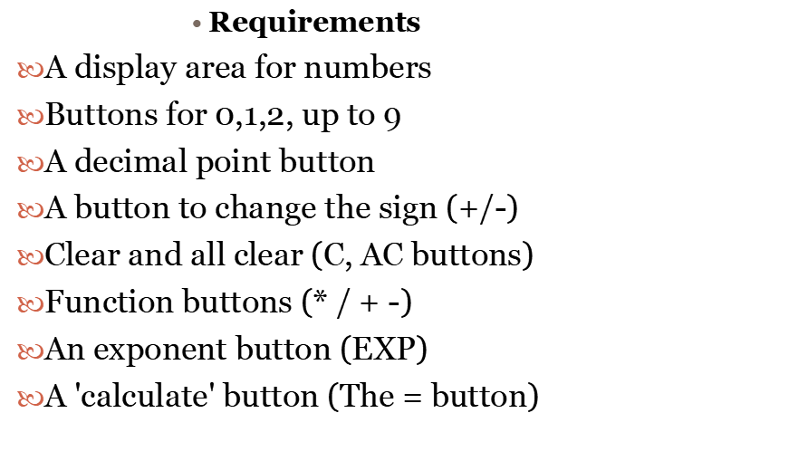
Design a calculator

Slide 32
<div align="center">
<table width="30%" border="4"> <tr>
<td colspan="2"align="center">Display Area</td></tr>
<tr><td>Numeric Buttons</td> <td>Function Buttons</td> </tr></table></div>

Slide 33
<input type="button">
Which gives us a general-purpose button. To each of these buttons we'll attach a:
OnClick="DoSomething()" 'event handler', so that when we click on the button, we can expect a response.

Slide 34
More detailed HTML for basic calculator
<FORM name="Calculator">
<table border="4">
<tr> <!--TOP PANEL------>
<td colspan="2">A Simple JavaScript Calculator<br> <input type="text" maxlength="40" size="30" name="Display"> </td> </tr>
<!--END TOP PANEL--->
<tr> <td> <!--LEFT PANEL------>
<table> <tr> <td><input type="button" value="7"></td> <td><input type="button" value="8">
</td> <td><input type="button" value="9"></td> </tr> <tr> {all other rows of digits are similar..} </tr> </table> </td>
<!--END LEFT PANEL--> <td> <!--RIGHT PANEL-----> <table> {right panel is similar in overall structure to left} </table> </td><!--END RIGHT PANEL-> </tr></table>
</FORM>

Slide 35
output
..\internet technology\calculator1.html

Slide 36
Email validation
..\internet technology\email.html

Slide 37
Phone Number Validation._x000b_.\internet technology\phone.html

Slide 38
Javascript Array
An array is a special variable, which can hold more than one value at a time.
<p id="demo"></p>
<script>
var cars = ["Saab", "Volvo", "BMW"];
document.getElementById("demo").innerHTML = cars;
</script>

Slide 39
Push operation
<html>
<body>
<p>Click the button to add new elements to the array.</p>
<button onclick="myFunction()">Try it</button>
<p id="demo"></p>
<script>
var fruits = ["Banana", "Orange", "Apple", "Mango"];
document.getElementById("demo").innerHTML = fruits;
function myFunction() {
fruits.push("Kiwi", "Lemon", "Pineapple");
document.getElementById("demo").innerHTML = fruits;
}
</script>
</body>
</html>

Slide 40
JavaScript Regular Expressions
A regular expression is a sequence of characters that forms a search pattern.
When you search for data in a text, you can use this search pattern to describe what you are searching for.
A regular expression can be a single character, or a more complicated pattern.
Regular expressions can be used to perform all types of text search and text replace operations.

Slide 41
A regular expression is an object that describes a pattern of characters.
Regular expressions are used to perform pattern-matching and "search-and-replace" functions on text.

Slide 42
Syntax
Example
var patt = /w3schools/i
i Perform case-insensitive matching
g Perform a global match (find all matches rather than stopping after the first match)
m Perform multiline matching
/pattern/modifiers;

Slide 43
[abc] | Find any character between the brackets
[^abc] | Find any character NOT between the brackets
[0-9] | Find any digit between the brackets
[^0-9] | Find any digit NOT between the brackets

Slide 44
Example
var str = "Visit W3Schools";
var n = str.search(/w3schools/i);
Output:
6

Slide 45
Use String replace() With a Regular Expression
<html>
<body>
<p>Replace "microsoft" with "W3Schools" in the paragraph below:</p>
<button onclick="myFunction()">Try it</button>
<p id="demo">Please visit Microsoft!</p>
<script>
function myFunction() {
var str = document.getElementById("demo").innerHTML;
var txt = str.replace(/microsoft/i,"W3Schools");
document.getElementById("demo").innerHTML = txt;
}
</script>
</body>
</html>
Replace "microsoft" with "W3Schools" in the paragraph below:
Please visit Microsoft!

Slide 46
Check input for 5 digit number
<html>
<body>
<script>
function checkpostal()
{
var re5digit=/^\d{5}$/
if (document.myform.myinput.value.search(re5digit)==-1)
alert("Please enter a valid 5 digit number inside form")
}
</script>
<form name="myform">
<input type="text" name="myinput" size=15>
<input type="button" onClick="checkpostal()" value="check">
</form>
</body>
</html>

Slide 47
var re5digit=/^\d{5}$/
^ indicates the beginning of the string. Using a ^ meta character requires that the match start at the beginning.
\d indicates a digit character and the {5} following it means that there must be 5 consecutive digit characters.
$ indicates the end of the string. Using a $ meta character requires that the match end at the end of the string.

Slide 48
<html>
<body>
<p>Click the button to perfom a global search for the letters "ain" in a string, and display the matches.</p>
<button onclick="myFunction()">Try it</button>
<p id="demo"></p>
<script>
function myFunction() {
var str = "The rain in SPAIN stays mainly in the plain";
var res = str.match(/ain/g);
document.getElementById("demo").innerHTML = res;
}
</script>
</body>
</html>
Click the button to perform a global search for the letters "ain" in a string, and display the matches.
ain,ain,ain

Slide 49
Example
Perform a global, case-insensitive search for "ain":
var str = "The rain in SPAIN stays mainly in the plain";
var res = str.match(/ain/gi);
Output:
ain,AIN,ain,ain

Slide 50
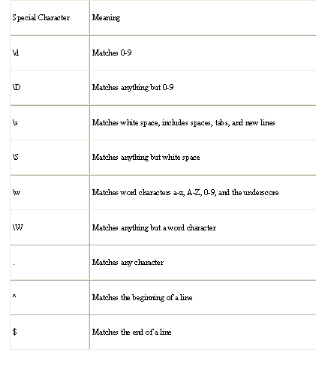

Slide 51
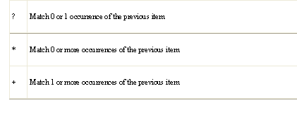

Slide 52
var myRegExp = /\$\d?\d\.\d\d/;
var myText = " The hot dog cost $1.75!";
This expression will match the dollar sign, followed by one or two digits, followed by the decimal point (i.e., period), followed by two digits. From Table 2, you can see the "?" character means match 0 or 1 of the preceding item. In this expression, it means match zero or one digits.

Slide 54
Prompt()
html><body>
<p>Click the button to demonstrate the prompt box.</p>
<button onclick="myFunction()">Try it</button>
<p id="demo"></p>
<script>
function myFunction() {
var person = prompt("Please enter your name", "Harry Potter");
if (person != null) {
document.getElementById("demo").innerHTML =
"Hello " + person + "! How are you today?";
}
}
</script></body></html>

